Slide 1

CoC Basics
Washoe County Housing and Homeless Services

Slide 2

What is the CoC?
People working together to solve homelessness in their community
Policy
Shared Data
Priorities for Resources
Avoid Silos
Efficient Use of Limited Resources

Slide 3
What is the CoC?
A HUD “program”
Per HUD: The Continuum of Care (CoC) Program is designed to promote communitywide commitment to the goal of ending homelessness;
provide funding for efforts by nonprofit providers, and State and local governments to quickly rehouse homeless individuals and families while minimizing the trauma and dislocation caused to homeless individuals, families, and communities by homelessness;
promote access to and effect utilization of mainstream programs by homeless individuals and families; and
optimize self-sufficiency among individuals and families experiencing homelessness.
National Alliance to End Homelessness
A Continuum of Care (CoC) is a regional or local planning body that coordinates housing and services funding for homeless families and individuals.
In 1995, the US Department of Housing and Urban Development (HUD) began to require communities to submit a single application for McKinney-Vento Homeless Assistance Grants in order to streamline the funding application process, encourage coordination of housing and service providers on a local level, and promote the development of Continuums of Care (CoCs).
By requiring communities to submit a single application, HUD hoped to encourage a more structural and strategic approach to both housing and providing services to homeless people. A CoC would provide this more strategic system by providing homeless people with housing and services appropriate to their range of needs.

Slide 4
What is the CoC?
The “Collaborative Applicant” is responsible for:
Completing a consolidated application annually
Annual community application for funding
Monitoring CoC grantees
Annual monitoring, impacts subsequent application scoring
Managing Coordinated Entry
No wrong door, standardized assessment and single prioritized list of people experiencing homelessness for housing referrals to made off of
Point in Time Count
Once per year count the last 10 days in January
Maintaining HMIS
Homeless Management Information System
Communitywide database for people experiencing homelessness
HUD reporting
CoC wide aggregate numbers reported quarterly and annually
https://www.ecfr.gov/current/title-24/subtitle-B/chapter-V/subchapter-C/part-578

Slide 5

Consolidated Application
Agencies complete program applications for funding
Rating and Ranking Committee
CoC Application
Permanent Supportive Housing
Rapid Re-Housing
Supportive Services
Each application is rated
Applications are ranked
overall score based on a variety of factors including program performance
The committee makes decisions on what projects are the top priority
Opportunity to priorities specific program types or subpopulation
Includes the program applications, rating and ranking and the CoC Application
HUD evaluates us based on community wide policy implementation CoC performance
FY 24--$3.1 million in funding!

Slide 6
Funding Competition Details
Utilization of contracted facilitator for Rating and Ranking
Reallocation—can be voluntary or involuntary
Each NOFO dictates new funding opportunities and reallocation limitations
Timelines can vary, at least 60 days must be provided between NOFO release and Collaborative Applicant (community) application due
Tier 1 versus Tier 2
Tier 1 is generally understood as guaranteed to be funded
Tier 2 competes national with all other Tier 2 projects nationally
Collaborative Applicant application score impacts a portion of each grantees project application

Slide 7
CoC Grantee Monitoring
Each CoC is charged with monitoring it’s grantees annually
HUD may also elect to monitor a program
HUD is the funder and holds the grant agreement and may assess fiscal penalties
We are currently utilizing a contractor to conduct monitoring
The monitoring results factor into the subsequent program application for CoC rating

Slide 8
Point in Time Count
Required by HUD for each CoC to conduct a PIT count at least once every two years
Must be in the last 10 days in January (unless a waiver is granted)
Results are reported locally and to HUD
Generally, generates lots of local media coverage
HUD data is used to produce an annual nationwide report
In 2021, an “observation only” count was conducted due to COVID-19
In 2022, returned to the historical count methodology
In 2025, only conducted sheltered count, no unsheltered count conducted
In 2026, both a sheltered and unsheltered count will be conducted

Slide 9
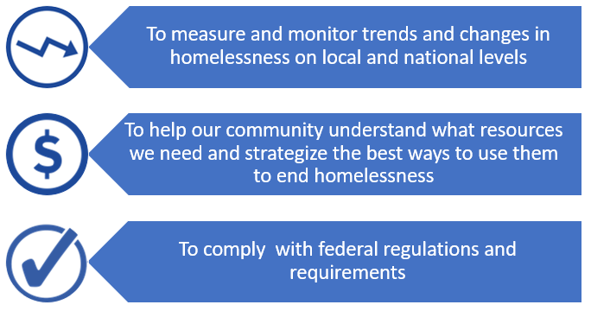
Why do a PIT count?

Slide 10

Who is counted in the PIT count?
Data Pulled From HMIS
Sheltered PIT Count
Unsheltered PIT Count
Emergency shelters (including those using hotel and motel vouchers)
Transitional housing
Safe Havens
Car
Park
Abandoned building
Bus or train station
Airport
Camping ground
Parking Lot
Motel count—not required by HUD

Slide 11
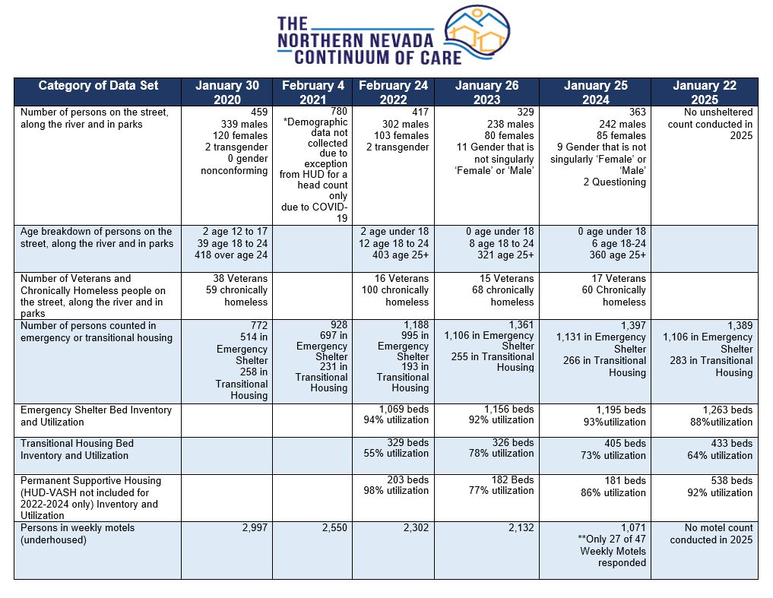
The Northern Nevada CoC

Slide 12
2019-2025 Point in Time

Slide 13
Bed Utilization
Emergency Shelter Bed Utilization
1,263 beds available
88% Utilization Rate
Transitional Housing Bed Utilization
433 Beds available
64% Utilization Rate
Permanent Supportive Housing Bed Utilization
538 Beds Available
92% Utilization Rate
All Bed Type Utilization
1,696 Beds Available
85% Utilization Rate

Slide 14

HMIS
What is HMIS?
Homeless Management Information System
Database of all people experiencing homelessness in our community
Bitfocus is the statewide vendor
Bitfocus is also the HMIS Administrator
HUD specific role
Responsible for data collection, data checks and submission to HUD
WCHHS Goal: Get more agencies using HMIS
40% to 90% HMIS usage
Better data tracking
Applies a consistent data standard

Slide 15
Local Structure
Northern Nevada Continuum of Care Leadership Council “NNCLC”
Operates per approved bylaws
Governance structure
Formal Membership roster
Regional Alliance to End Homelessness
Stakeholder group
Anyone is welcome
Information sharing on new policy, programs and general updates
https://www.washoecounty.gov/homeless/CoC/index.php

Slide 16
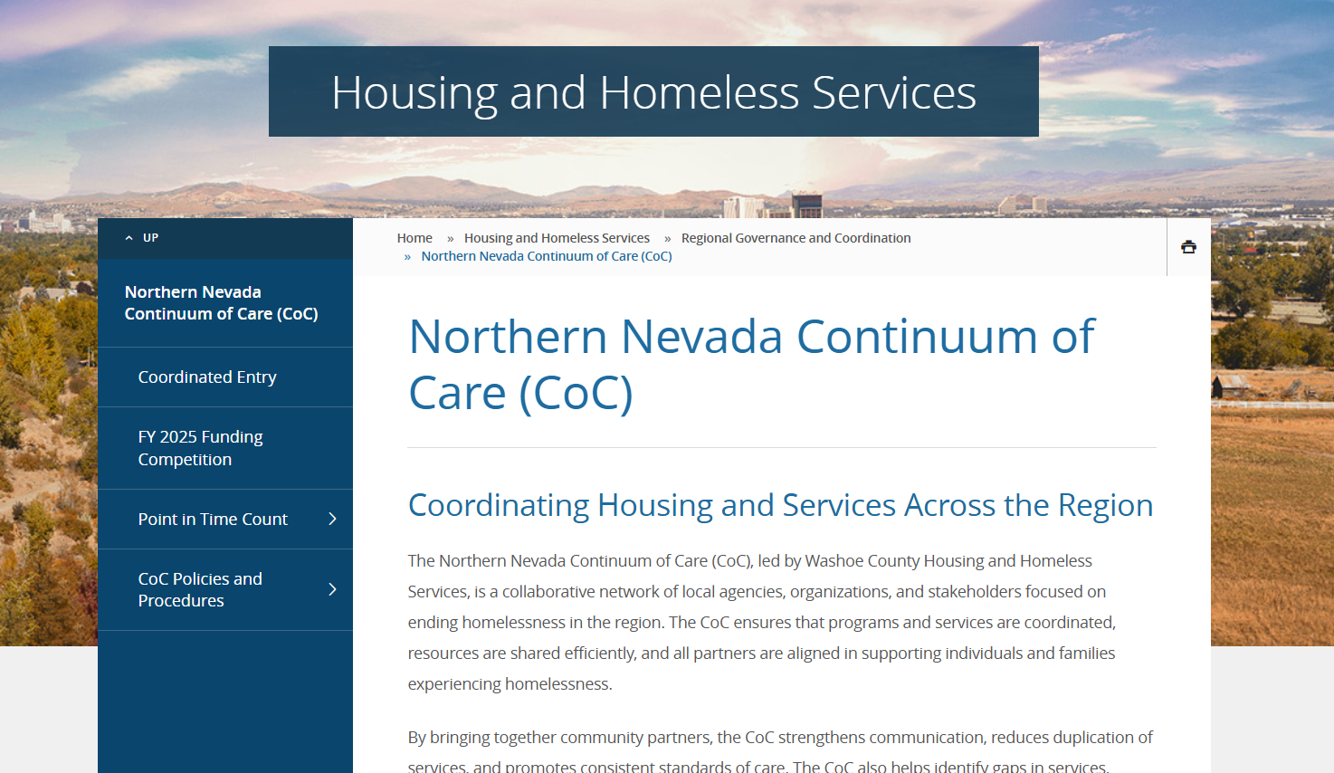
NNCLC Website
Background info on NNCoC
https://www.washoecounty.gov/homeless/regional_governance_and_coordination/coc/index.php
Training resources, all current CoC policy, PIT information and annual funding competition information

Slide 17

Southern Nevada Homelessness CoC
Southern Nevada Homelessness Continuum of Care
Brenda Barnes, SNHCoC Director
Clark County Social Services

Slide 18

Mission & Vision Statement
Mission & Vision Statement
Mission To promote a community-wide commitment to ending homelessness.
Vision A Southern Nevada where everyone has access to safe, dignified housing.

Slide 19
Guiding Principles
We believe in the equal dignity of all people, regardless of background or identity. Our work is guided by:
Making homelessness rare, brief, and non-recurring
Person-centered, trauma-informed care
A Housing First approach
Inclusivity and diverse perspectives
Transparent service delivery
Data-driven, action-oriented strategies

Slide 20
CoC Membership
Individuals and agencies can become formal CoC Members by signing and submitting a CoC Membership Agreement, available on the CoC HelpHopeHome website. Membership is open year-round and must be renewed every two years.
Each member agency must designate one voting representative. Additional non-voting participants are encouraged, with no limit on their number. There are no term limits for CoC members.
The Collaborative Applicant manages the official CoC membership list and listserv.

Slide 21
CoC
Board Composition
CoC Board (15 Voting Members; 3 Ex-Officio Members)
Lived Expertise |  | Community Representatives | Consolidated Plan | Ex Officio (non-voting)
Youth Advisory Board (1) | Lived X Consultants (2) | CoC Member-Elected Positions (8) | Jurisdictions (4) | Collaborative Applicant (1) | HMIS Lead (1) | Coordinated Entry Lead (1)
Board Composition
Voting Members (15 total):
Lived Expertise (3): Youth Advisory Board (1), Lived X Consultants (2)
Elected Representatives (8)
Jurisdictional Representatives (4)
Ex-Officio (Non-Voting) Members (3):
Collaborative Applicant
HMIS Lead
Coordinated Entry Lead

Slide 22
Jurisdictional Partners
5 Government Agencies
Clark County
North Las Vegas
Las Vegas
Henderson

Slide 23

Notice of Funding Opportunity & Monitoring FY2025/2026

Slide 24
CoC Notice of Funding Opportunity
NOFO FY2025/2026
Funding Priorities: Focuses on reducing homelessness by adding new permanent supportive housing (PSH) and renewing existing effective projects.
Application Process: Involves project rankings based on local evaluations, with a November 2025 NOFO release followed by competitive applications.
Delayed Funding Protections: If FY2025 awards are delayed, the law directs HUD to renew expiring projects based on a specific schedule, starting with Q1 2026 expirations.
Key Requirements: Projects must meet local threshold requirements, including performance data and financial oversight.

Slide 25
CoC Monitoring
Monitoring
Purpose: Ensures compliance with HUD regulations, grant performance, and adherence to NOFO priorities.
Monitoring Layers: Recipients monitor subrecipients, the CoC monitors recipients, and HUD monitors recipients.
Procedures: Typically includes agency self-assessments, on-site client file reviews, and Homeless Management Information System (HMIS) security checks.

Slide 26
Updates to Nevada Interagency Advisory Council on Homelessness to Housing 3/19/26
Federal Reporting
System Performance Measures (SPM)
Submitted on 3/4/2026
Annual Homeless Assessment Report (AHAR) to Congress
Point in Time (PIT) and Housing Inventory Count (HIC)
Submission TBA by HUD
Longitudinal System Analysis (LSA)
Submitted in January

Slide 27
AHAR – Federal Reports

Slide 28
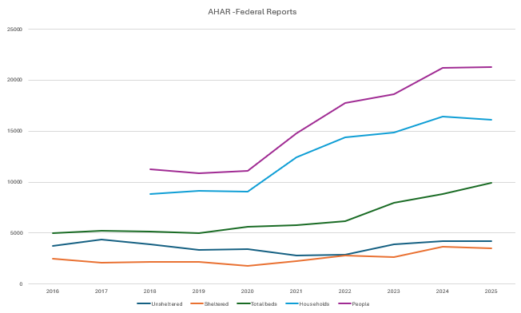
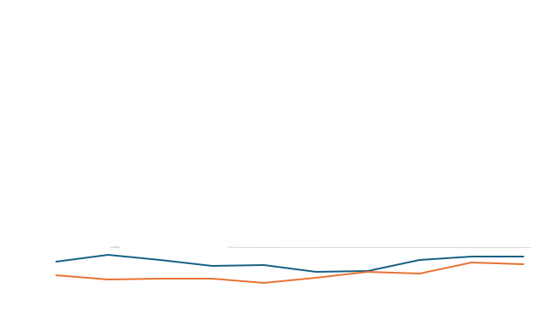
Point in Time
PIT – Point in Time
Single day in the last 10 days of January
Unsheltered – physical counts
Sheltered – counts from ES and TH projects in HMIS

Slide 29

HIC – Housing Inventory Count
HIC – Housing Inventory Count
Single day in the last 10 days of January
Total Beds – from ES, TH, RRH, PSH project data in HMIS

Slide 30
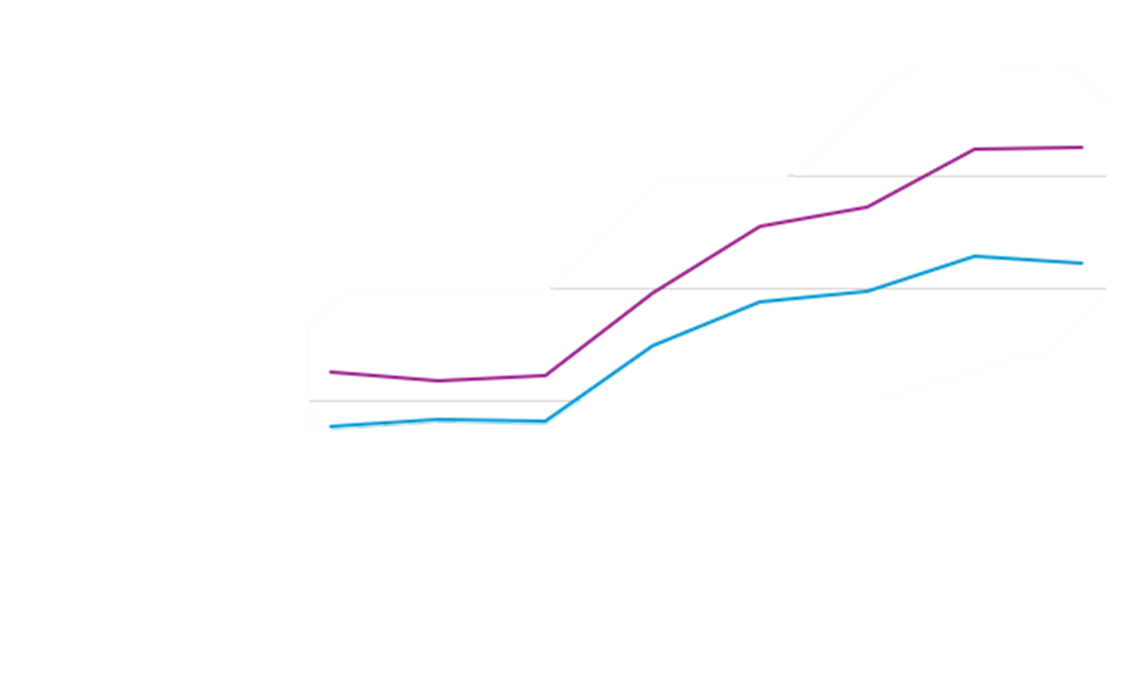
LSA-Longitudinal System Analysis
LSA – Longitudinal System Analysis
October 1 – September 30
Households – from ES, TH, RRH, and PSH projects in HMIS
Individuals – from ES,
TH, RRH, and PSH projects in HMIS

Slide 31
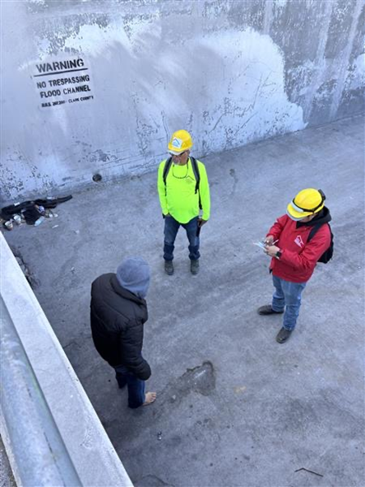

Point and Time Count Day Overview

Slide 32
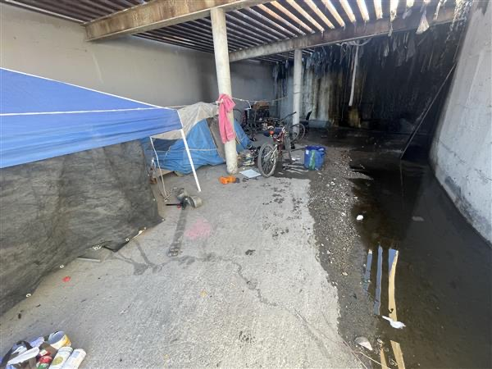
Duration of PIT Count
The above-ground count lasted a total of 10 hours and 20 minutes, while the tunnel count lasted 12 hours and 45 minutes
Deployment Site | Start Time | End Time
City of Las Vegas | 3:00 AM | 12:18 PM
HELP | 4:00 AM | 4:40 PM
HopeLink | 4:48 AM | 12:34 PM
City of North Las Vegas | 5:00 AM | 9:44 AM
US Vets | 5:00 AM | 10:11 AM
Desert Breeze | 5:00 AM | 11:06 AM
Boulder City | 5:00 AM | 11:33 AM
Cambridge | 5:00 AM | 12:00 PM
Bldg and Fire | 5:00 AM | 12:00 PM
Mtn Crest | 5:00 AM | 1:00 PM
NPHY | 6:25 AM | 1:20 PM
Henderson | 7:00 AM | 12:05 PM

Slide 33
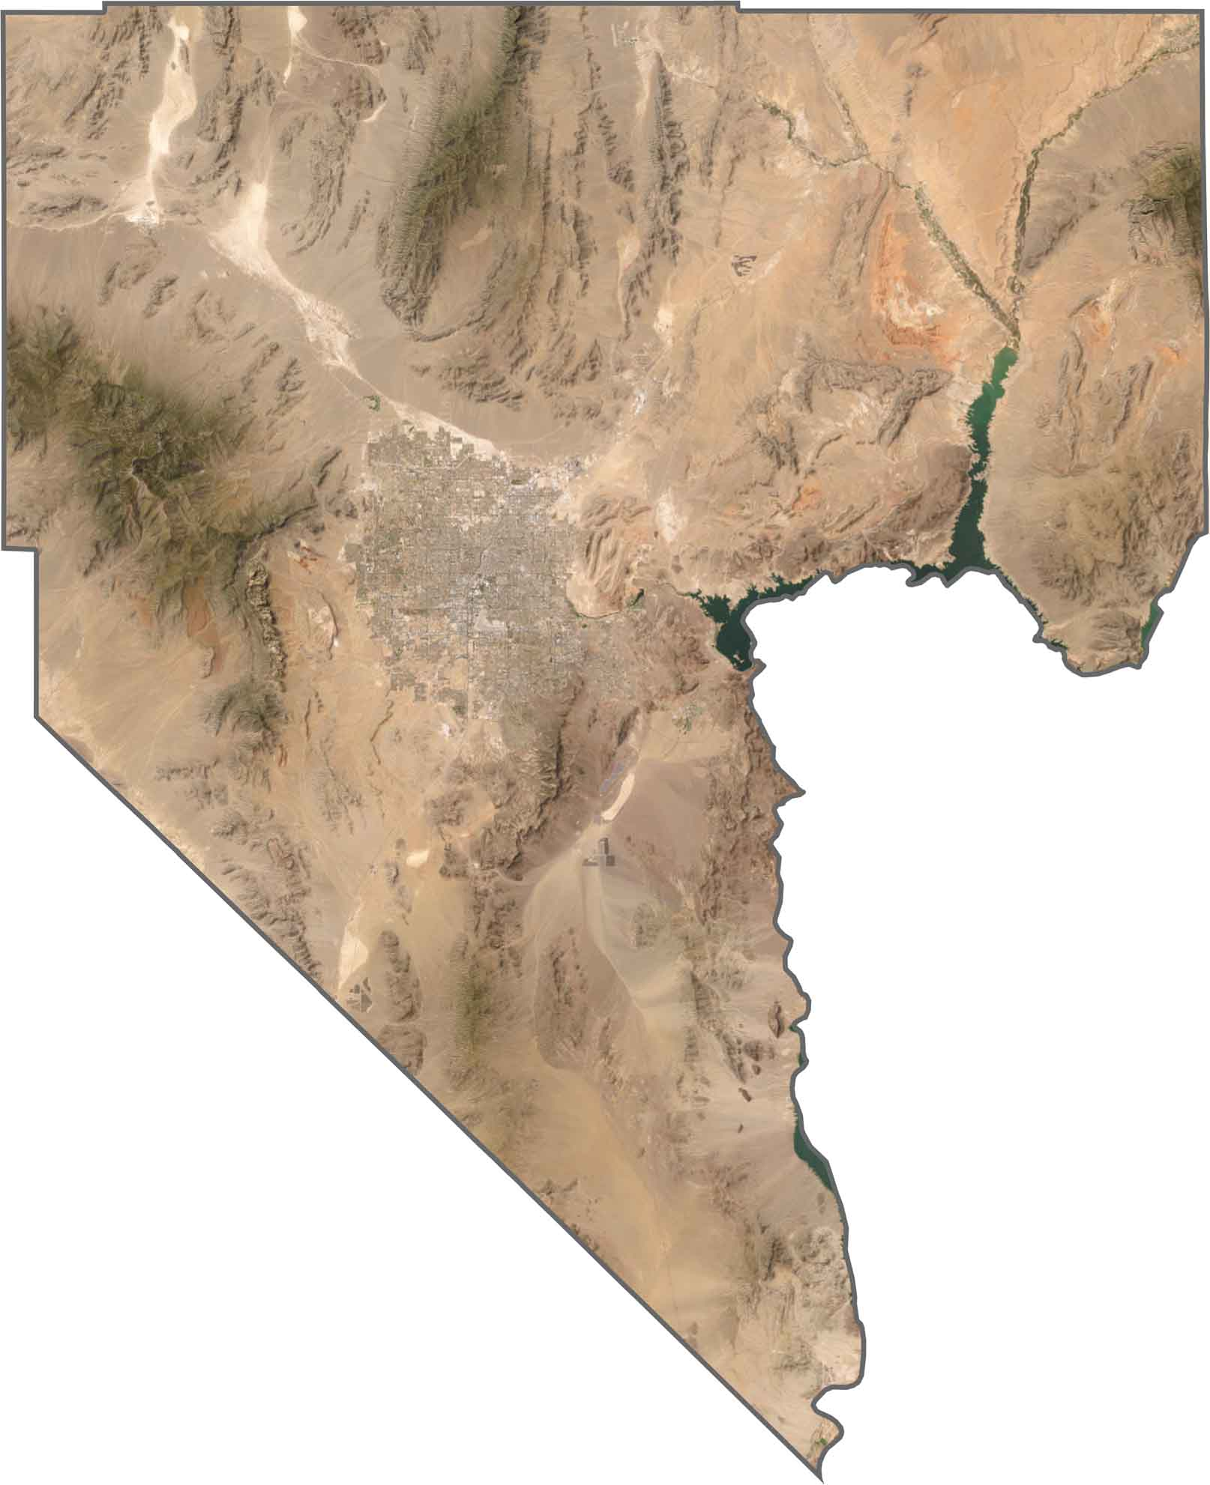
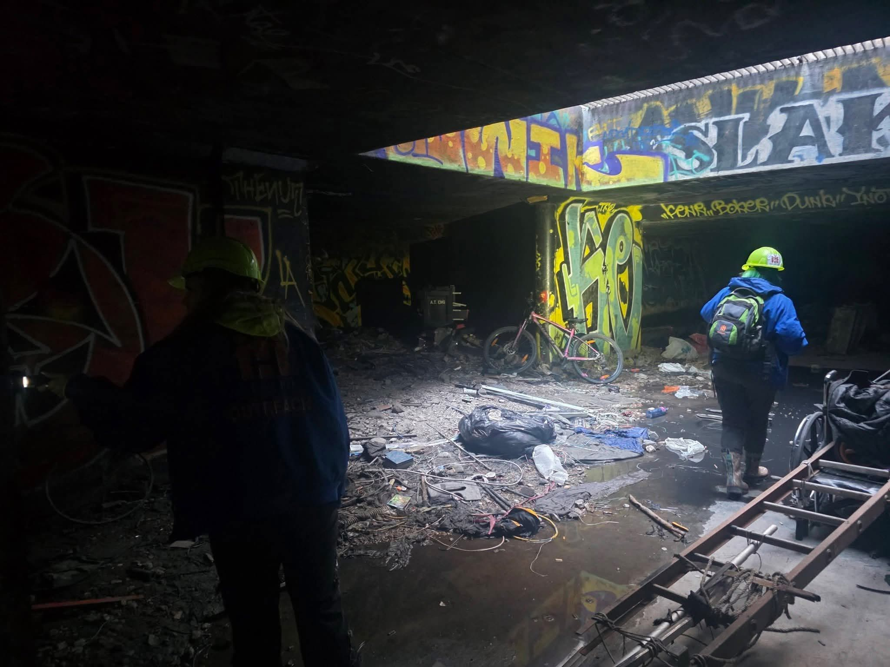
PIT Count Day Surveys
Clark County (City of Las Vegas/City of North Las Vegas/ Boulder City/ Unincorporated Clark County)
2003 completed surveys
Mesquite
12 completed Surveys
Laughlin
6 completed surveys
A total of 2,021 surveys were completed across all areas.
Notes:
Over 526 staff and volunteers supported every deployment site
Location Data
Once the physical PIT Count is completed, the survey data is downloaded from the app and checked for location issues. Some surveys were performed outside the CoC, unable to get geolocated, or cancelled. Once the location issues are resolved, the tunnel count and main count are compared to ensure that surveys aren’t duplicated between the tunnel team and our regular teams. Next, the interviews from the main survey are compared by initials and date-of-birth information to further minimize duplication.
Demographic Data
With the knowledge that response rates are never 100%, HUD publishes their own tool for demographic extrapolation. Unfortunately, this tool requires an 80% response rate where ours is historically in the low 20% range. As an alternative to the HUD tool, we create our community’s demographic profile from de-duplicated street outreach data from November of the previous year through the end of January in the year of the scheduled count. Using a broad sample of street outreach throughout the winter season provides a better understanding of our unsheltered community’s demographics.
Review and Submission
Once the de-duplication is completed and our demographic profile is applied, the report is ready for review. A good method to check the report is to enter it into the HUD submission portal where it will flag any possible data quality issues. Once these issues are resolved, the unsheltered portion of the PIT is ready for submission. This data is combined with emergency shelter data, obtained from HMIS to form the full PIT Count.
This is the point we would usually share these numbers with commissioners, then jurisdictions and the media. Withholding dissemination until the tentative HUD submission is vital to having a consistent message to the public.

Slide 34

Resources
Resources
HelpHopeHome.org
Online Resource Guide
Printable Pocket Resource Guide
Resource Dashboard
Community Calendar
Fact Sheets
Regional, State, and Federal Plans to End Homelessness
Nevada 2-1-1
Online resource guide: www.nevada211.org
Call 2-1-1 or 1-866-535-5654
Text your zip code to 898211 (Live text chat)
Chat with Nevada 2-1-1 online (Live online chat)
ClarkCountyNV.gov
Rent and utility assistance program overview and applications
Overview of CARE teams
Undocumented Immigrant Resources
Transportation Assistance Information (return to respective state)
Burials and cremation assistance
Disabled and senior adult supportive services
AI Chatbot to review client eligibility
Office locations
Landlord partner portal & recruitment

Slide 35
Resources
Brenda Barnes
Manager, Community Support
SNHCoC Director
Email: MartinBV@ClarkCountyNV.gov

